Slide 1
Trainer Action Pack
A Guide to the Session
Notes:
About this Action Pack
This session takes 60 minutes. The session includes information for you the presenter, activities for participants, and a debrief for each activity.
Notes Section
In the notes section, you will find a complete guide to each slide including timing, what to say, related activities and debriefs. You can read from the notes like a script or feel free to adapt and add to the content to make it relevant for your program. One thing to note is that instructions in italics are instructions to you, the presenter.
Activities
There are instructions throughout the session for both in-person and virtual versions of the activities. Use whichever format best suits your implementation of the session.
Debrief
Debriefs follow each activity and are comprised of two parts: Observe & Identify Concepts and Apply Concepts.
Observe & Identify: As the facilitator of the session, observe participants during the activity and be prepared to comment on your observations. Participants should identify concepts from the activity and discuss.
Apply Concepts: The last part of the debrief is taking the identified concepts and having participants discuss applying those concepts to the context of your program.
How to Adapt this Session
You can expand this session by:
Spending more time on the activities as needed or desired.
Adapting the examples and scenarios to align with your program.

Slide 2
The Welcome Toolkit
Building Connections from Day One
Notes:
1 min
0:01-0:01
Say​
A strong start to the school year makes all the difference in your out-of-school time program. This session will give you some simple, ready-to-use activities that help youth connect with you and each other, creating a welcoming space from day one. You'll learn practical ways to get students' attention and understand what it looks like when youth are engaged.
​
Materials Needed
If you are facilitating this training in-person:
Copies of the Self-Reflection and Evaluation tool for all participants
Copy of the mirror image
Curious wheel found at https://wheelofnames.com/4em-2ua or you can customize your own
Blank paper for all participants and something to write with
Audio and Wi-Fi to play videos
If you are facilitating this training virtually:
Prepare the polls on slides 8, 10, 12, 14, 16, 19
Curious wheel found at https://wheelofnames.com/4em-2ua or you can customize your own
Mirror image activity found at https://drive.google.com/file/d/1gDpizNIGdOjL2liJAt3dX6MnylTlR_Gb/view?usp=drive_link or your can customize your own

Slide 3

Defining Youth Engagement
But they’re not being disruptive.
They’re doing the activities.
They do like to get prizes.
Notes:
2 mins
0:05-0:07
Say
Let’s take a moment to start with what youth engagement is not.
Youth engagement is not compliance.
Just because a young person is sitting quietly, nodding along, or completing activities doesn’t mean they’re engaged. That might just mean they’re compliant – they’re doing what they’re told. But engagement isn’t about obedience. Engagement is about investment. When youth are truly engaged, they’re thinking, questioning, contributing, and connecting what they’re doing to something that matters to them.
Youth engagement is also not busy work.
Giving youth something to do just to keep them occupied doesn’t make it meaningful. Whether it’s coloring pages, worksheets, or repetitive tasks, if the activity doesn’t have purpose, choice, or challenge, it’s not engagement. In fact, it can actually have the opposite effect, leading to boredom, frustration, or checked-out behavior.
Youth engagement is not just about rewards or tokenism.
Giving out prizes, points, or pizza might get participation, but it doesn’t guarantee engagement. External rewards can motivate short-term behavior, but they don’t build long-term interest or ownership. Similarly, inviting one young person to speak on behalf of many, or adding a youth voice just to check a box, isn’t real engagement either. True engagement means involving youth in shaping decisions, not just reacting to them. It’s about meaningful participation, not just appearance.

Slide 4
Why Engagement Matters
Engagement
Autonomy, Skill-Building, Purpose
Notes:
2 mins
0:07-0:09
Say
When we talk about youth engagement, it’s easy to focus on what’s happening in the moment and all the things we’ve already talked about today like: Are they participating? Are they interested? Are they showing up? But real engagement does more than just help a program run smoothly. It lays the foundation for life-long growth. When we invest in connection, motivation, and agency, we’re helping young people build the mindset and skills they’ll carry with them far beyond our programs.
Youth who experience real choice, voice, and leadership begin to see themselves as capable decision-makers. They learn how to assess options, advocate for their needs, and take initiative. These are essential life skills, whether they’re choosing a college, applying for a job, or navigating relationships.
In engaging environments, youth practice collaboration, problem-solving, communication, and persistence. They learn how to manage frustration, work through challenges, and reflect on what they’ve learned. These aren’t just 'program skills’ they’re human skills that set the stage for success in school, work, and life.
Engagement fosters a sense of purpose. When youth are emotionally invested, when they connect what they’re doing to what they care about, they start to ask bigger questions like: Who am I? What do I value? How can I contribute? A sense of purpose isn’t something we give them but it is something we can help them discover through meaningful experiences and opportunities to make an impact.
So yes, engagement helps your program run better today. But more importantly, it helps young people grow into adults who are self-directed, skilled, and grounded in purpose. And that’s a powerful legacy.

Slide 5
Pillars of Engagement
Connection
Motivation
Agency
Notes:
2 mins
0:09-0:11
Say
When we talk about youth engagement in OST, we’re not just talking about whether kids are showing up or behaving. We’re talking about whether they feel invested, inspired, and empowered. That’s where the three pillars of engagement come in: connection, motivation, and agency. These are the foundations that help youth go from just attending a program to wanting to be there, and thriving while they are.
First, connection. This is all about relationships. Youth need to feel safe, seen, and valued. That could mean a strong relationship with a staff member, a sense of belonging with peers, or a personal connection to the activity itself. Without connection, it’s hard to care. And when youth feel disconnected, engagement quickly fades.
Second, motivation. Motivation is the spark; it’s the internal drive that keeps youth curious and committed. We build motivation by making learning relevant, offering meaningful challenges, and helping youth see progress. It’s not about forcing participation, but instead it’s about fueling it.
And third, agency. Agency is the sense that my voice matters and my choices shape my experience. When youth have agency, they’re not just following directions –they’re contributing ideas, solving problems, and making decisions. Agency turns passive participants into active leaders.
When all three pillars are strong – connection, motivation, and agency – youth engagement becomes powerful, personal, and lasting. That’s what we’re working toward in every program, every day.

Slide 6
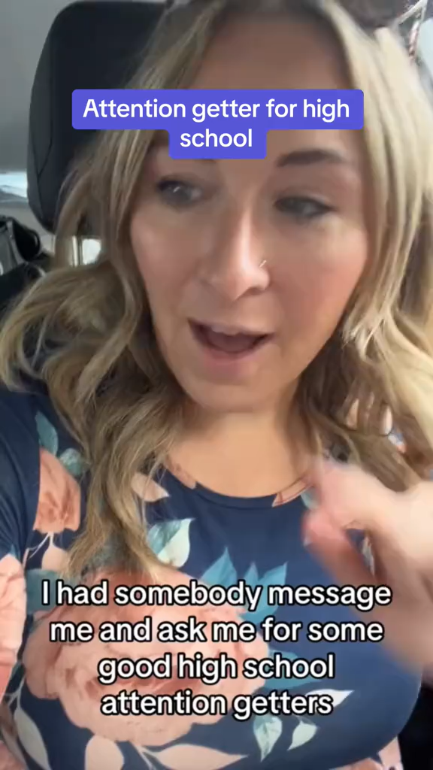
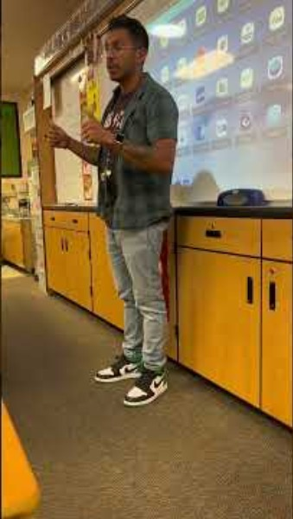
First Things First, Attention Getters!
Remind youth of norms
Refocus attention
Manage transitions
Improve engagement
Notes:
5 mins
0:11-0:16
Say
Let’s start with attention getters. We’ve all heard these, whether you’ve been working in OST one week or 10 years. They can be simple, like “1-2-3, eyes on me” but they have real purpose. Let’s look at the purposes of attention getters:
First, attention getters remind youth of norms. “1-2-3, eyes on me”, while catchy and it rhymes at its root reminds youth of the expectation to look and listen to the leader.
Second, they refocus attention, they bring youth from their individual conversations to the group conversation. “1-2-3, eyes on me” helps support this by redirecting the focus to one common point in the room.
Attention getters can also be a great way to manage transitions. Often after we give instructions, there will be several minutes of noise as youth move and navigate those instructions. Attention getters can help function as the end of the transition time.
Finally, the most effective transition getters also improve engagement, they get students excited about what they’re going to do next. This takes an attention getters that’s a little more intricate than “1-2-3, eyes on me.” What about this call & response where you say, “Up next, you’re going to...” and the youth say, “...find out something that might surprise you!”
We’ve got a few examples for younger students and a few examples for high school students that we’re going to look at now. Let’s start with the younger students – this educator has a whole list of attention getters he uses. Then we’re going to see how a high school educator thinks about this, with a little bit of a different twist that focuses more on improving engagement.
Ask Now we want to hear from you, what attention getters are you using in your classroom. You can share in the chat or unmute and share.
This is a great start, we’re going to share some more as we go through today’s session so we have a whole arsenal of attention getters – why? Because they stop working when they get old and boring.
Source
https://www.youtube.com/shorts/EeRGj_AUtC0
https://www.tiktok.com/@tisdrj/video/7262876592265907499?is_from_webapp=1&web_id=7504304506441483806

Slide 7
Activities & Approaches
Approaches
Activities
Help youth feel known
Planned for groups
Used in “in-between” moments
Individualized
Notes:
1 min
0:16-0:17​
Say
Today we’re going to invite you to be more intentional and inclusive in how you relate to each other, with a goal of deepening and strengthening the relationships that young people experience in their lives. It gives two ways to nurture developmental relationships with and among young people:
Structured activities that create personal connections with and among young people that bring the five elements of Search Institute’s Developmental Relationships Framework to life.
Everyday approaches that help integrate the five elements of the Developmental Relationships Framework into programs, curricula, and practice.
Source
Search Institute. Relationship Builder’s Guidebook. January 2021 Version ed., Minneapolis, MN, Search Institute, Jan. 2021.

Slide 8
Express Care
Emerging Emojis
Colorful Conversations
Be dependable
Listen
Believe in me
Be warm
Encourage
Notes:
7 mins
0:17-0:24
In-Person Activity – Self Assessment
We’re going to do a quick self-reflection around how we express care for our youth. Take your Self-Reflection and Evaluation Tool and look at the self-reflection column and think if you asked youth, and they were answering truthfully, would they say you express care often, sometimes or rarely? Jot your answers on your handout. Your answers are just for you.
Virtual Activity – Poll
We are going to do a quick self-reflection poll. I want you to think about your youth – if you asked them, and they were answering truthfully, would they say you express care often, sometimes or rarely? Your answers are confidential.
Questions
Show me that I can trust you.
Really pay attention when we are together.
Make me feel like you really know me and value me.
Show me that you enjoy being with me.
Praise my efforts and achievements.
Answers
Often
Sometimes
Rarely
Say
We develop assets in youth when we express care for them. Care is intentional it means:
Be dependable - Be someone I can trust.
Listen - Really pay attention when we are together.
Believe in me - Make me feel known and valued.
Be warm - Show me you enjoy being with me.
Encourage - Praise me for my efforts and achievements.
Activity – Chat box/Discussion
Click to display.
One activity we can use to do this is Emerging Emojis – take a look at the last 3 emojis you sent – it can be via text, Snapchat, or whatever you use. If doing the session virtually ask everyone to share theirs in the chat. We’re going to ask a few people to share about their emojis. Facilitate share out and discuss how we can use something like this to support expressing care.
Another way you could do this is through Colorful Conversations. Give youth a small handful of M&Ms and tell them not to eat them, then give them a code that has them share a different fact about themselves based on the color. Once you share you can eat that candy. Continue around the table or group sharing until you run out of time or all of the candies have been eaten. These are just some quick examples of getting-to-know-you activities.
While this activity is typically used for introductions when a group is just starting to get to know one another, consider bringing this activity and other activities like this back over your time together. You can modify the questions or topics to 1) increase the level of risk in questions to build trust, 2) use this to check in on what’s is happening in participant’s lives, or 3) have youth ask one another follow-up questions.
Questions to think about:
How might you build in more opportunities for listening?
How could you show young people that you enjoy being with them?
How can you recognize their efforts and achievements to encourage them?
Sources
Search Institute. “Developmental Relationships Brainstorm.” Search Institute, Search Institute, pub.search-institute.org/protected/intentional/Developmental_Relationships_Brainstorm.pdf?__hstc=75443661.1db14c5b158fd9e255280305635a47bb.1731358602431.1736536730168.1736775292686.8&__hssc=75443661.3.1736775292686&__hsfp=3011104808. Accessed 13 Jan. 2025.
Search Institute. “Developmental Relationships.” Search Institute, 2024, searchinstitute.org/developmental-relationships.
Search Institute. Relationship Builder’s Guidebook. January 2021 Version ed., Minneapolis, MN, Search Institute, Jan. 2021.

Slide 9
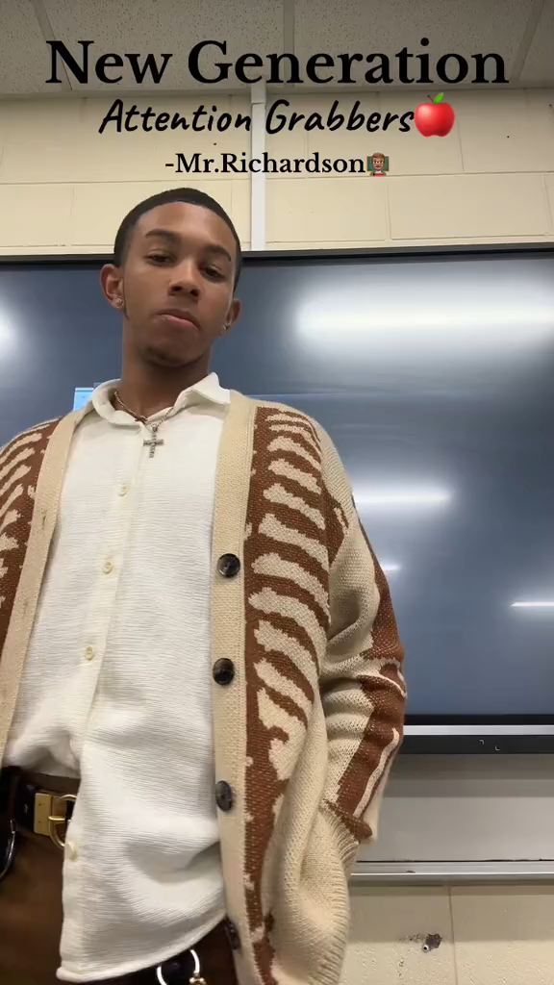
We Be Vibin'
Call and Response
Hakuna
  Matata
Scooby, Scooby Doo
  Where are you?
Hocus pocus
  Everybody focus
Notes:
1 mins
0:24-0:25​
Say
Call and response is a popular attention getter amongst staff and youth. These can be very creative and connect to pop culture and student interests. There are a lot of call-and-response style attention getters. Here’s a fun one to try. Click to play video.
Some others that you can consider are: Click twice to display each one.
Hakuna…matata
Scooby, Scooby Doo….where are you?
Hocus pocus….everybody focus
Source
https://www.tiktok.com/@ajayy3cool/video/7289509956695493931?is_from_webapp=1&sender_device=pc&web_id=7504304506441483806

Slide 10
Challenge Growth
What Do a Cat & a Fridge Have in Common?
Spinning Coin
Expect my best
Stretch
Hold me accountable
Reflect on Failures
Notes:
7 mins
0:25-0:32
In-Person Activity – Self Assessment
We’re going to do a quick self-reflection around how we challenge growth for our youth. Take your Self-Reflection and Evaluation Tool and look at the self-reflection column and think if you asked youth, and they were answering truthfully, would they say you challenge growth often, sometimes or rarely? Jot your answers on your handout. Your answers are just for you.
Virtual Activity – Poll
We are going to do a quick self-reflection poll. I want you to think about your youth – if you asked them, and they were answering truthfully, would they say you challenge growth often, sometimes or rarely? Your answers are confidential.
Questions
Show me that you expect me to be my best.
Push me to try harder.
Tell me that I need to take responsibility for my actions.
Help me learn from mistakes and setbacks.
Answers
Often
Sometimes
Rarely
Say
We develop assets in youth when we challenge growth for them. Challenging growth is intentional it means:
Expect my best - Expect me to live up to my potential.
Stretch - Push me to go further.
Hold me accountable - Insist I take responsibility for my actions.
Reflect on failures - Help me learn from mistakes and setbacks.
Activity – Chat box/Discussion
Click to display.
Grab some paper and something to write with. We are going to have a competition to see who can come up with the most things that a cat and a fridge have in common. You are going to have 1 minute to list things that a cat and a fridge have in common. After 1 minute, we’ll ask for a volunteer to share their list. You will cross off anything from your list that they share. The person who has the most unique things on their list wins bragging rights.
Once complete, ask participants to read out lists.
How can this activity help challenge growth in youth? What questions could you ask them to support the development of this skill? Drop your answers in the chat.
Another way you can do this is to see with group can keep a coin spinning the longest. You are going to try spinning the coin as many time as you can in the time we have. Your table is going to be your team. You can test to see what works best – you can test the different coins, test to see which person is the best spinner, and which surface is best to spin on. One of you is going to be the coin spinner, one person needs to keep the time – you can either use a stop watch – we have a few up here – or your phones, and one person is going to be the recorder, writing down the results.
Questions to think about
How can you communicate your expectations for young people to live up to their potential?
How could you help youth stretch to do more than they knew they were able to do?
If youth fail at a task, how might you use the opportunity to help them learn from the setback?
Sources:
Search Institute. “Developmental Relationships Brainstorm.” Search Institute, Search Institute, pub.search-institute.org/protected/intentional/Developmental_Relationships_Brainstorm.pdf?__hstc=75443661.1db14c5b158fd9e255280305635a47bb.1731358602431.1736536730168.1736775292686.8&__hssc=75443661.3.1736775292686&__hsfp=3011104808. Accessed 13 Jan. 2025.
Search Institute. “Developmental Relationships.” Search Institute, 2024, searchinstitute.org/developmental-relationships.
Search Institute. Relationship Builder’s Guidebook. January 2021 Version ed., Minneapolis, MN, Search Institute, Jan. 2021.

Slide 11
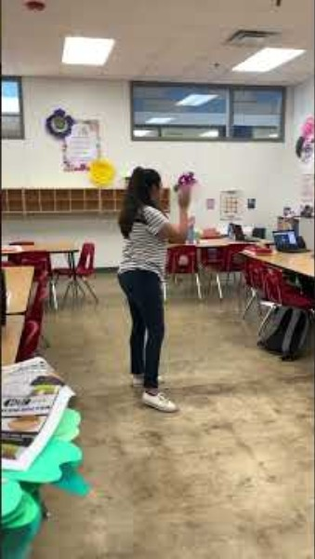
Rhythm
Non-verbal
Rhythmic clapping
“If you hear my voice clap once…”
Notes:
1 mins
0:32-0:33
Say
Rhythm can be a great attention getter. You can mix up your clapping patterns and incorporate a rhythmic clap-back. Check out this video for some other ideas. Play video.
Source
https://www.youtube.com/shorts/A2s-S2hpKJo

Slide 12
Provide Support
Sketching Blind
Navigate
Empower
Advocate
Set boundaries
Notes:
7 mins (3 slides)
0:33-0:40​
In-Person Activity – Self Assessment
We’re going to do a quick self-reflection around how we provide support for our youth. Take your Self-Reflection and Evaluation Tool and look at the self-reflection column and think if you asked youth, and they were answering truthfully, would they say you provide support often, sometimes or rarely? Jot your answers on your handout. Your answers are just for you.
Virtual Activity – Poll
We are going to do a quick self-reflection poll. I want you to think about your youth – if you asked them, and they were answering truthfully, would they say you provide support often, sometimes or rarely? Your answers are confidential.
Questions
Guide me through hard situations.
Build my confidence to take charge of my life.
Stand up for me when I need it.
Put limits in place to keep me on track.
Answers
Often
Sometimes
Rarely
Say
We develop assets in youth when we provide support for them. Providing support is intentional it means:
Navigate - Guide me through hard situations and systems.
Empower - Build my confidence to take charge of my life.
Advocate - Stand up for me when I need it.
Set boundaries - Put in place limits that keep me on track.
In-Person Activity – Sketching Blind
Click to display.
Grab some paper and something to write with. While you do that, we are looking for a volunteer. We are going to give the volunteer an image. They are going to look at the image and describe it to all of you. With your paper and writing utensil, you are going to try to draw it.
Identify volunteer and give them time to describe and participants time to draw.
We are going to show off our pictures now. Let’s hold them up and look at what other people drew.
Virtual Activity – Sketching Blind
Click to display.
Grab some paper and something to write with. While you do that, we are looking for a volunteer. We are going to send the volunteer an image in a direct chat. They are going to look at the image and then unmute themselves and describe it to all of you. With your paper and writing utensil, you are going to try to draw it.
Identify volunteer and give them time to describe and participants time to draw.
We are going to show off our pictures now. If you have a background on, you may need to either turn it off or place your picture in front of your body so that everyone can see it. Let’s hold them up and look at what other people drew.

Slide 13
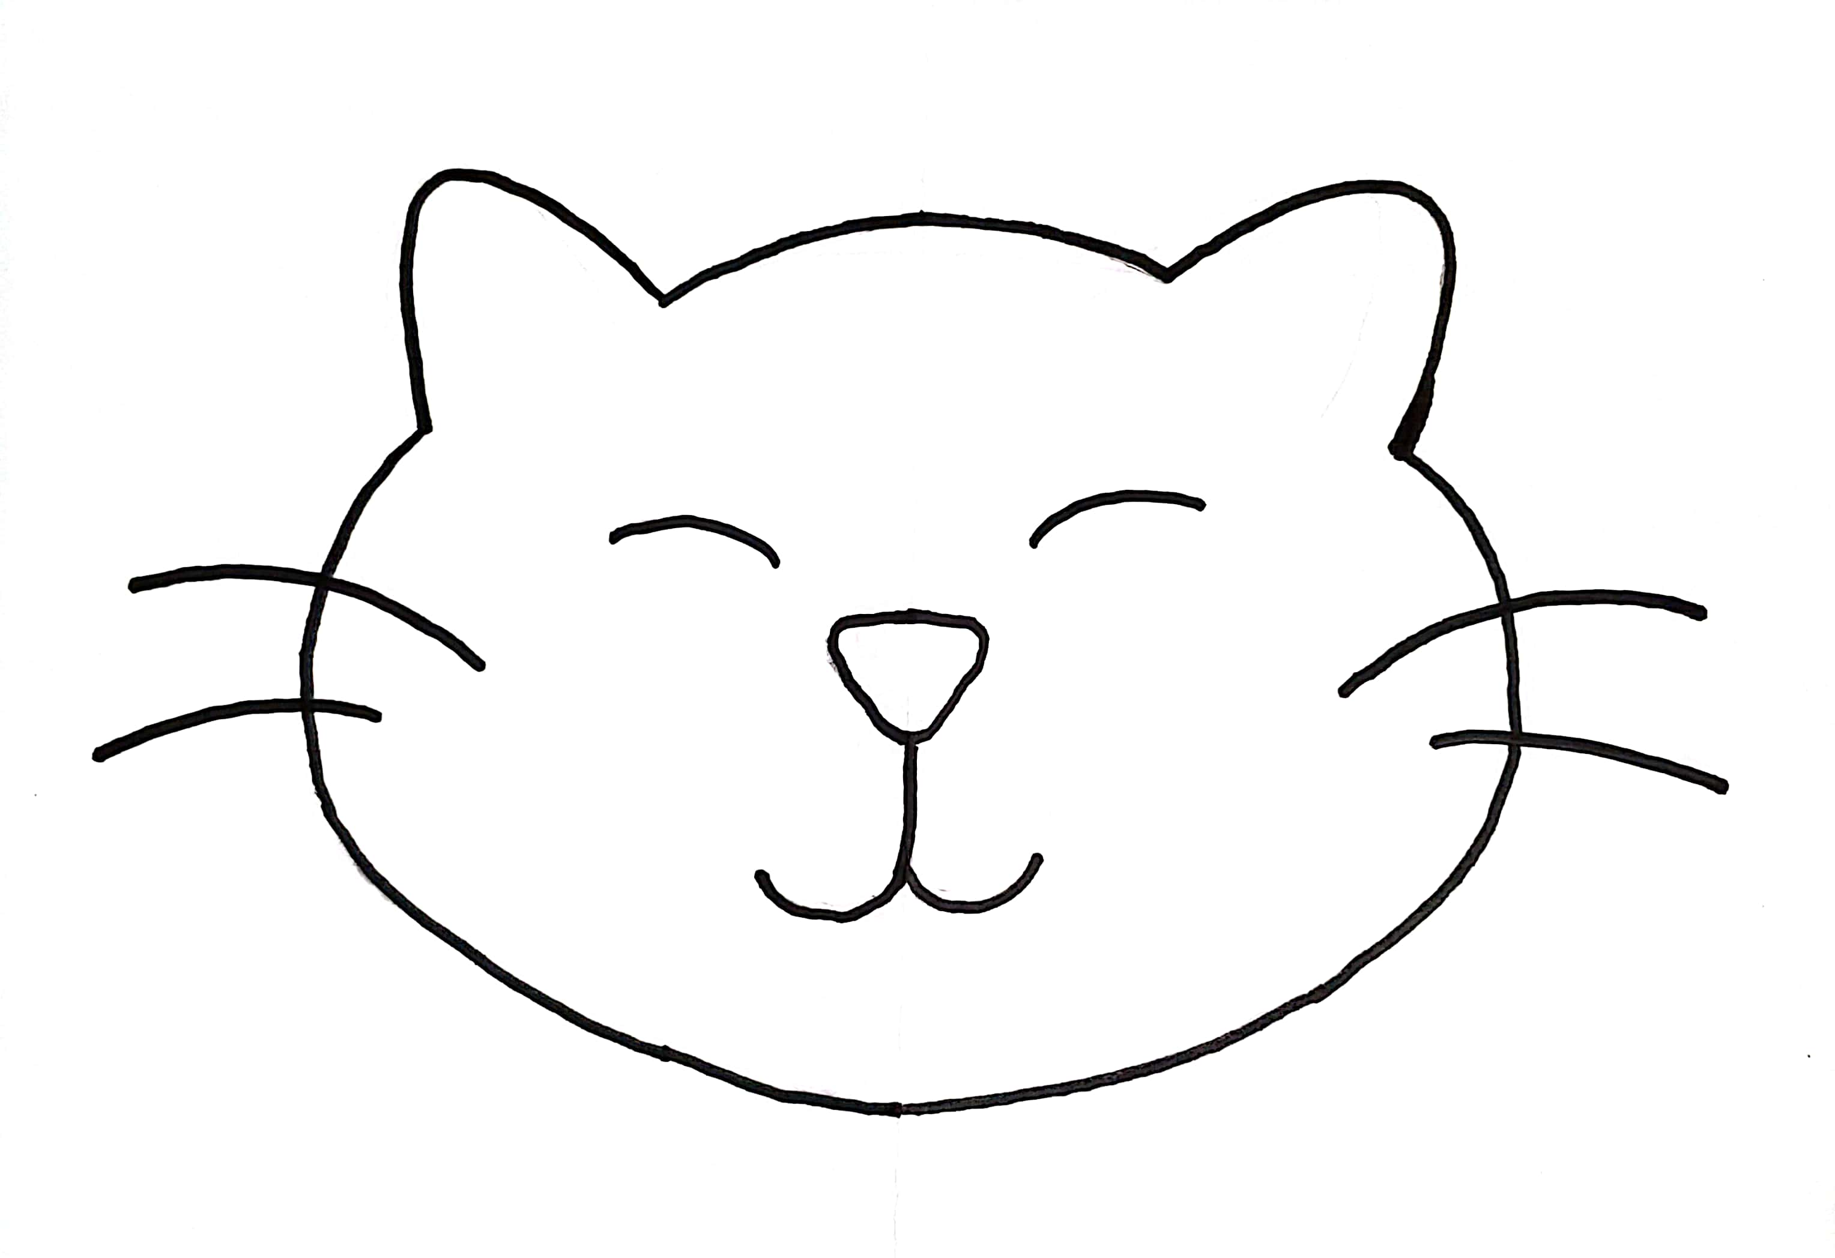
Notes:
Show off the image. Facilitate a discussion with the group with these questions to think about.
What did the guide do that made it easier for you to draw? What did they do that made it harder?
Did the drawers do anything to make it easier or harder to guide them?
How could you expand on this activity if you had more time?
What is one thing you do in real life with friends to provide guidance or support?
Think of a time in the past when someone has helped you. What did they say or do that felt supportive and helpful?

Slide 14
Provide Support
Sketching Blind
Navigate
Empower
Advocate
Set boundaries
Notes:
Another in-person way you could do this is assign partners and have one partner put on a blindfold. Have youth guide their partners to the target location without touching them. Youth can say things like “take 3 steps forward” or “turn left” to help them safely navigate.
Providing support depends on what the other person needs in a relationship at a given time. Sometimes it’s helpful to be an advocate for
someone and other times it’s best to help them empower themselves. Providing support can also help others achieve their goals. Sometimes we
need guidance when we are setting goals. This fun, interactive activity gets youth thinking about how to best give someone guidance and how to navigate, building those skills.
Questions to think about
How can you help youth learn how to navigate difficult situations or systems?
How can you help young people build their confidence and feel empowered to achieve their goals?
What kinds of material supports might young people need (e.g. food, materials, transportation) to be successful?
Sources
Search Institute. “Developmental Relationships Brainstorm.” Search Institute, Search Institute, pub.search-institute.org/protected/intentional/Developmental_Relationships_Brainstorm.pdf?__hstc=75443661.1db14c5b158fd9e255280305635a47bb.1731358602431.1736536730168.1736775292686.8&__hssc=75443661.3.1736775292686&__hsfp=3011104808. Accessed 13 Jan. 2025.
Search Institute. “Developmental Relationships.” Search Institute, 2024, searchinstitute.org/developmental-relationships.
Search Institute. Relationship Builder’s Guidebook. January 2021 Version ed., Minneapolis, MN, Search Institute, Jan. 2021.

Slide 15
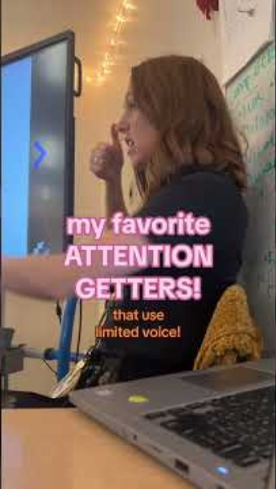
Signals
Non-verbal
Quiet coyote
Peace sign
Raised hand
Notes:
1 mins
0:40-0:41
Say
The next attention getter in this collection is non-verbal, this one is going to require some introduction with your students, but can be a good way to bring down the energy level in your classroom.
Some other popular ones to try include: Click to display each one.
Quiet coyote
Peace sign
Raised hand
Source
https://www.youtube.com/shorts/BWubS16EzVo

Slide 16
Share Power
Respect me
Include me
Collaborate
Let me lead
Public Service Announcements
Notes:
7 mins (2 slides)
0:41-0:48
In-Person Activity – Self Assessment
We’re going to do a quick self-reflection around how we share power with our youth. Take your Self-Reflection and Evaluation Tool and look at the self-reflection column and think if you asked youth, and they were answering truthfully, would they say you share power often, sometimes or rarely? Jot your answers on your handout. Your answers are just for you.
Virtual Activity – Poll
We are going to do a quick self-reflection poll. I want you to think about your youth – if you asked them, and they were answering truthfully, would they say you share power often, sometimes or rarely? Your answers are confidential.
Questions
Treat me fairly.
Include me in decisions that affect me.
Work with me to solve problems and reach goals.
Let me lead the way sometimes.
Answers
Often
Sometimes
Rarely
Say
We develop assets in youth when we provide support for them. Providing support is intentional it means:
Respect me-Take me seriously and treat me fairly
Include me-Involve me in decisions that affect me
Collaborate-Work with me to solve problems and reach goals
Let me lead-Create opportunities for me to take action and lead
Activity – PSA Video
We have a video to show you for this one of one way youth at Winter Gardens Elementary School in Montebello Unified School District were able to lead and talk about issues that matter to them.

Slide 17
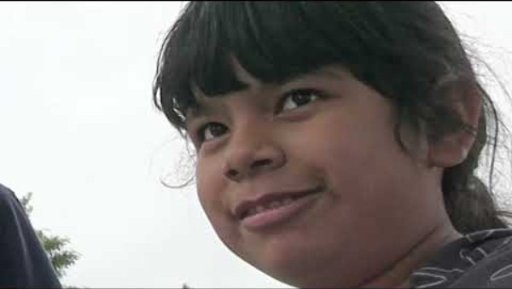
Notes:
Activity – Chat box/Discussion
We have a video to show you for this one of one way youth at Winter Gardens Elementary School in Montebello Unified School District were able to lead and talk about issues that matter to them.
Click to play.
Discuss
How could you use an activity like this to help students navigate hard situations they face?
How might you demonstrate that you take youth’s ideas seriously?
How might you actively involve young people in decision-making and/or collaborate with them to solve problems?
Are there opportunities to let young people take the lead?
Sources:
Search Institute. “Developmental Relationships Brainstorm.” Search Institute, Search Institute, pub.search-institute.org/protected/intentional/Developmental_Relationships_Brainstorm.pdf?__hstc=75443661.1db14c5b158fd9e255280305635a47bb.1731358602431.1736536730168.1736775292686.8&__hssc=75443661.3.1736775292686&__hsfp=3011104808. Accessed 13 Jan. 2025.
Search Institute. “Developmental Relationships.” Search Institute, 2024, searchinstitute.org/developmental-relationships.
Search Institute. Relationship Builder’s Guidebook. January 2021 Version ed., Minneapolis, MN, Search Institute, Jan. 2021.
https://youtu.be/pr9Y5VAqI2g

Slide 18
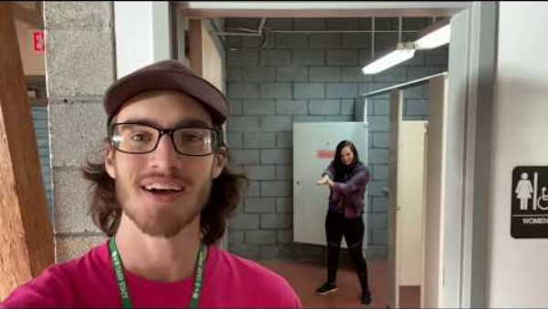
Singing and Sounds
Notes:
1 mins
0:48-0:49
Say
Here’s come camp staff sharing their favorite attention getters – these are also great OST attention getters.
Source
https://youtu.be/WCU2JMEgFVE

Slide 19
Expand Possibilities
What I Am Curious About
Inspire
Broaden horizons
Connect
Notes:
7 mins
0:49-0:56
In-Person Activity – Self Assessment
We’re going to do a quick self-reflection around how we expand possibilities for our youth. Take your Self-Reflection and Evaluation Tool and look at the self-reflection column and think if you asked youth, and they were answering truthfully, would they say you expand their possibilities often, sometimes or rarely? Jot your answers on your handout. Your answers are just for you.
Virtual Activity – Poll
We are going to do a quick self-reflection poll. I want you to think about your youth – if you asked them, and they were answering truthfully, would they say you expand possibilities often, sometimes or rarely? Your answers are confidential.
Questions
Inspire me to see possibilities for my future.
Expose me to new ideas, experiences, and places.
Introduce me to people who can help me learn and grow.
Answers
Often
Sometimes
Rarely
Say
We develop assets in youth when we expand possibilities for them. Expanding possibilities is intentional it means:
Inspire - Inspire me to see possibilities for my future.
Broaden horizons - Expose me to new ideas, experiences, and places.
Connect - Introduce me to people who can help me grow.
Activity – What I Am Curious About
Our youth are curious! We can use that to expand their possibilities. We are going to do a Curious Wheel – we’ll spin the wheel and ask for a volunteer to ask the group a question about the topic the wheel lands on. What you share can be serious or funny. For example, if the category is “social media” you could say you’re curious how people decide to present themselves online v. in person. If you can’t think of anything you’re curious about in that category, you can spin one more time. You can drop your answers in the chat.
Curious Wheel Link: https://wheelofnames.com/4em-2ua
Ask participants:
What ideas came up that you would be most curious to know more about?
Did someone want to learn about something you already know about?
How could you expand on this quick activity with youth or do a low-tech version? (Beach ball, paper plate spinner)
Expanding Possibilities focuses on connecting people with new ideas, people, places and experiences. This activity prompts participants to generate new ideas about things they want to learn more about and how they might connect each other with new resources. It’s a great way to talk about careers and youth futures.
Questions to think about
Are there opportunities to help young people imagine potential future pursuits?
How might you expose young people to new ideas, experiences and/or places?
How might you connect young people to others who can help them grow?
Sources
Search Institute. “Developmental Relationships Brainstorm.” Search Institute, Search Institute, pub.search-institute.org/protected/intentional/Developmental_Relationships_Brainstorm.pdf?__hstc=75443661.1db14c5b158fd9e255280305635a47bb.1731358602431.1736536730168.1736775292686.8&__hssc=75443661.3.1736775292686&__hsfp=3011104808. Accessed 13 Jan. 2025.
Search Institute. “Developmental Relationships.” Search Institute, 2024, searchinstitute.org/developmental-relationships.
Search Institute. Relationship Builder’s Guidebook. January 2021 Version ed., Minneapolis, MN, Search Institute, Jan. 2021.

Slide 20
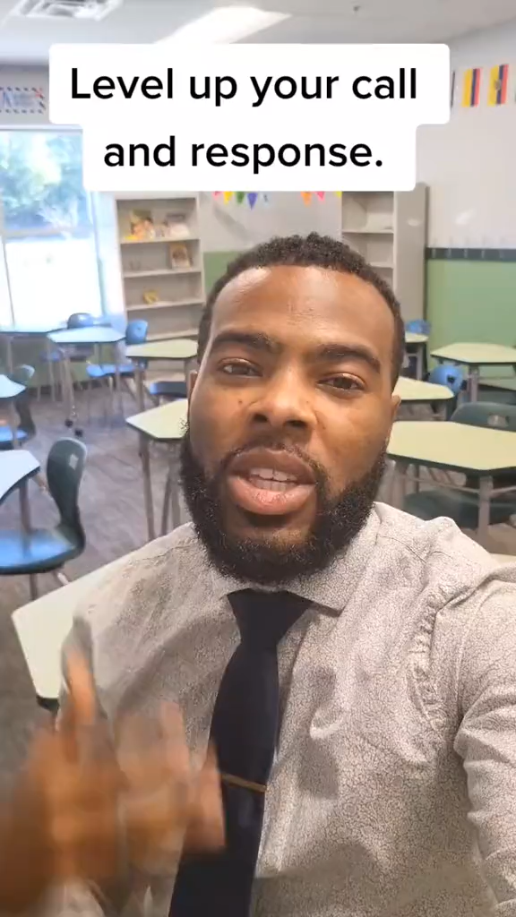
Make Your Attention Getter Stronger
Notes:
1 mins
0:56-0:57
Say
So you’ve tried some attention getters, maybe they’re working, maybe they’re not. Check out a recommendation on how to level up your call and response, getting better outcomes.
Source
https://www.tiktok.com/@darylwilliams__/video/7154139410693557550

Slide 21
Keep It Going
Implement clear attention getters
Create and maintain supportive and inclusive environments
Notes:
3 minutes
0:57-1:00
Say
To get you started with these strategies:
Teach and try one new attention getter this week
Try one activity to build relationships
Implement one approach with a youth that you want to build your relationship with

